Slide 1


Slide 2



This course material by Osama Salah is released under the following license:
Attribution-ShareAlike 4.0 International (CC BY-SA 4.0)
Conditions for use are published here:
https://creativecommons.org/licenses/by-sa/4.0/

Slide 3
Acknowledgement
I would like to thank and acknowledge the following people for their valuable contributions to this course material:
Have your name and effort acknowledged here!!!

Slide 4
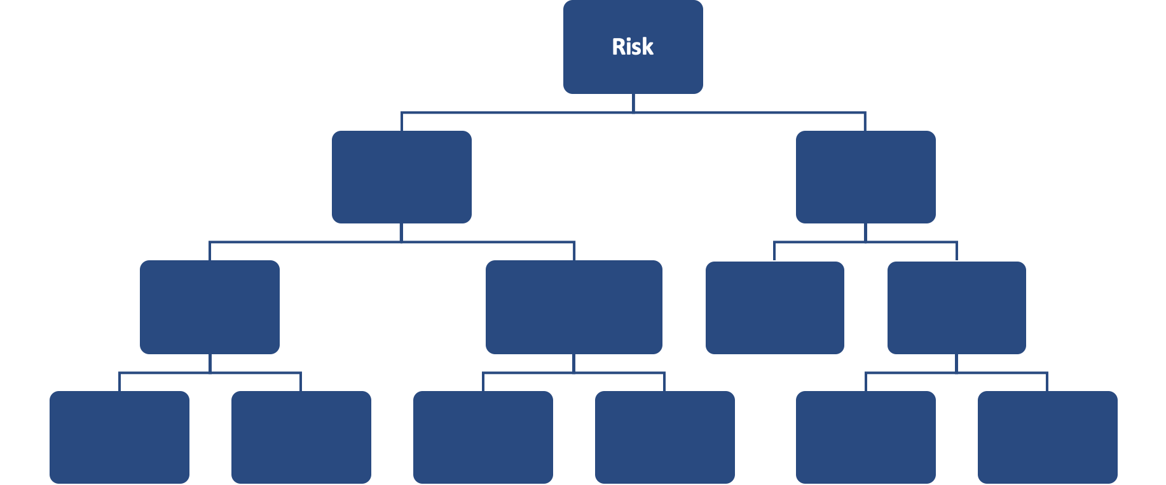
FAIR Open Course Module 01a – Why Quant RM? Ver. 0.2

Slide 5
Introduction
This module focuses on the shortcomings of qualitative risk management and why quantitative risk management is a more useful approach.

Slide 6
More Art than Science…
While many “Best Practices” and standards promote the use of qualitative risk management or specifically the use of Risk Matrices or Heat maps, there is no evidence of their value.
Risk Matrices are actually seriously flawed as we will see in the next slides.
Risk Matrices willfully ignore the insights gained from multiple domains.
Quantitative RM is based on validated methods.

Slide 7
Fake Math

Slide 8
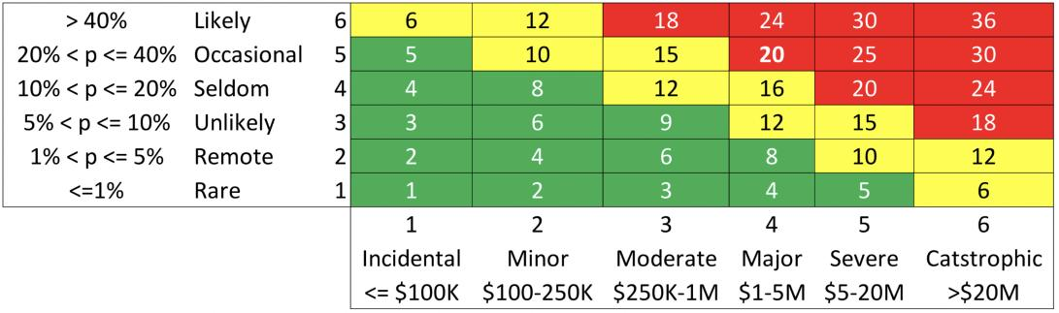
!
1-6 is an ordinal scale. It only indicates the order i.e. “3” comes after “2” etc.
The differences between each order is not really known.
We don’t know how much “3” is larger/better etc. than “2”.
The difference between “3” and “2” is not necessarily the same as between “3” and “4”.
You can not do math on an ordinal scale!!!

Slide 9
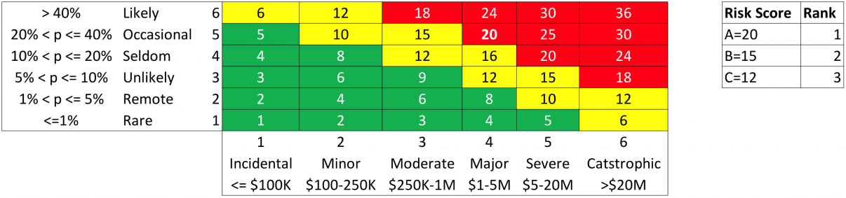
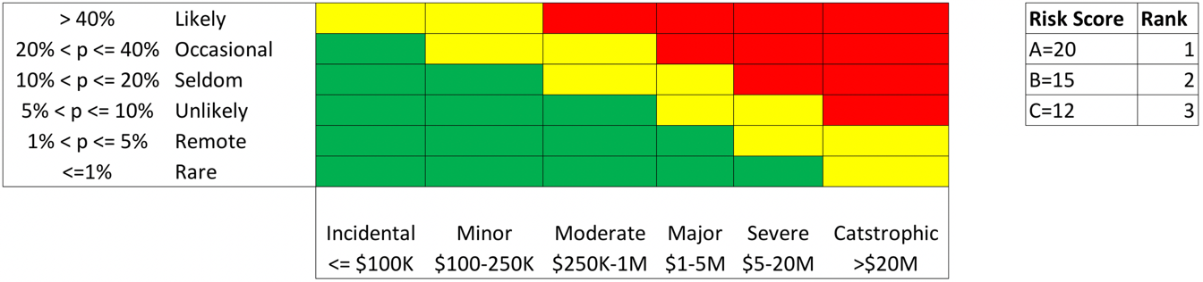
Ranking is arbitrary!
A
B
C
Reference: Thomas, Philip & Bratvold, Reidar & Bickel, J. (2013). The Risk of Using Risk Matrices.

Slide 10
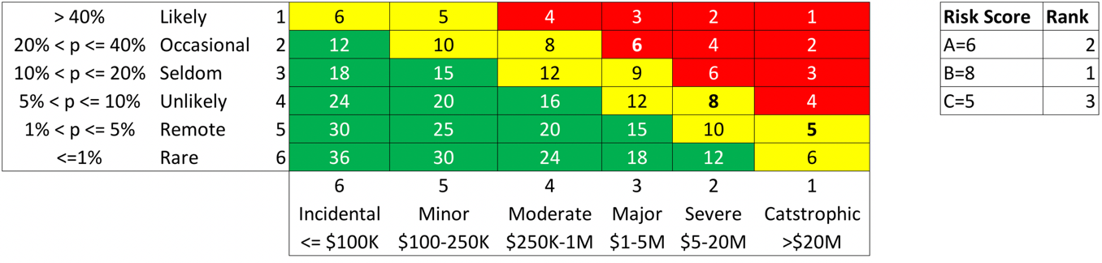
A
B
C
Ranking is arbitrary!
A
B
C
Reference: Thomas, Philip & Bratvold, Reidar & Bickel, J. (2013). The Risk of Using Risk Matrices.

Slide 11
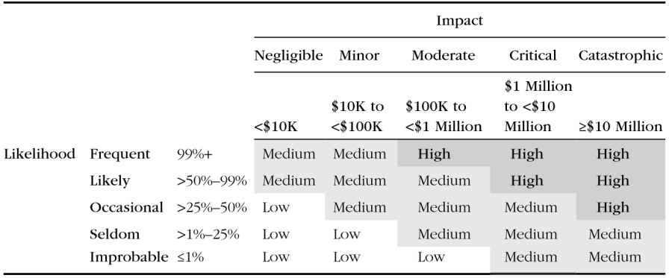
The Range Compression Problem
Risk A: Likelihood is 2%, impact is $10 million
Risk B: likelihood is 20%, impact $100 million
2% * $10 million = $200,000
20% * $100 million = $20 million
Reference: Douglas Hubbard, Richard Seiersen,“How to measure Anything in Cybersecurity Risk”

Slide 12
The Range Compression Problem
Risk A: Likelihood is 50%, impact is $9 million → 50% * $9 million = $4.5 million
Risk B: likelihood is 60%, impact $2 million → 60% * $2 million = $1.2 million
Reference: Douglas Hubbard, Richard Seiersen,“How to measure Anything in Cybersecurity Risk”

Slide 13
“The motivation for writing this paper was to point out the gross inconsistencies and arbitrariness embedded in RM. Given these problems, it seems clear to us that RMs should not be used for decisions of any consequence.”
“In this paper, we have illustrated and discussed inherent flaws in RMs and their potential impact on risk prioritization and mitigating.” … “These flaws cannot be corrected and are inherent to the design and use of RMs.”
Reference: Thomas, Philip & Bratvold, Reidar & Bickel, J. (2013). The Risk of Using Risk Matrices.

Slide 14
“The motivation for writing this paper was to point out the gross inconsistencies and arbitrariness embedded in RM. Given these problems, it seems clear to us that RMs should not be used for decisions of any consequence.”
“In this paper, we have illustrated and discussed inherent flaws in RMs and their potential impact on risk prioritization and mitigating.” … “These flaws cannot be corrected and are inherent to the design and use of RMs.”
Reference: Thomas, Philip & Bratvold, Reidar & Bickel, J. (2013). The Risk of Using Risk Matrices.

Slide 15
Modelling

Slide 16

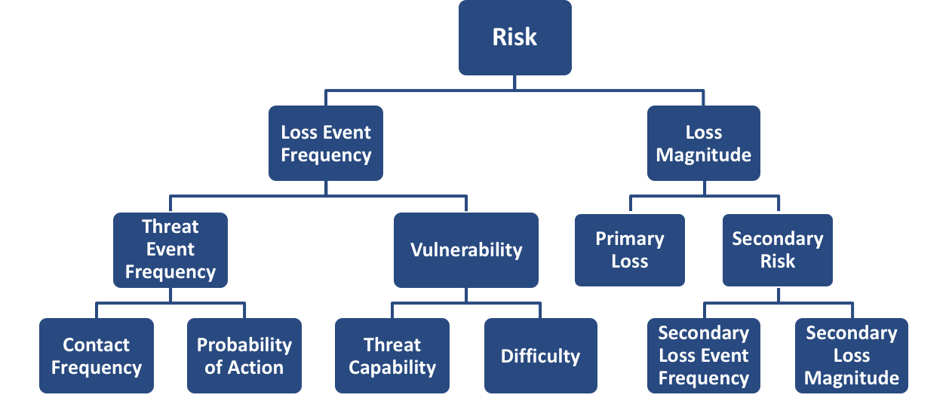
3. Modelling

Slide 17


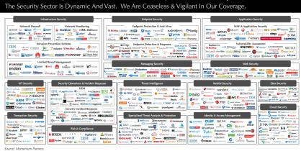





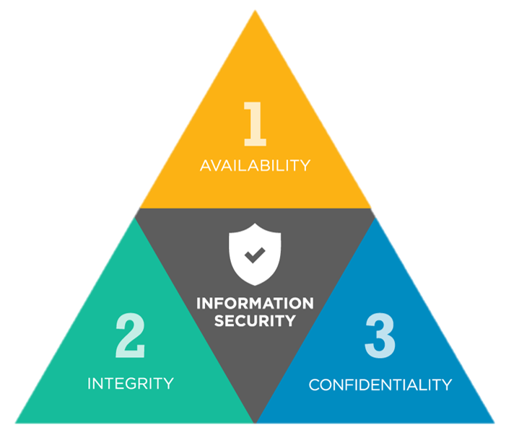
Malicious
Intention
Threat Type
Fraud
Technology
Motivation
Error
Threats
Technical
Controls
Administrative
Threat Capability
Preventive
Vulnerability
Detective
Losses
ISO
Stakeholders
Impact
NIST
Primary
“Best Practices”
Assets
Crown Jewels
secondary
Laws & Regulations

Slide 18
3. Modelling
Analysis involves the use of a model even if it’s just an informal mental model.
The mental model is a reflection of our understanding of a particular cause and effect relationship.
That understanding can change with time and between individuals which will lead to inconsistent analysis.
Models are lenses through which we process information and analyze complex systems and processes.

Slide 19
3. Modelling
We already know, through research, that we make better decisions using formal models instead of mental models.
However, the qualitative approach ignores this insight and offers nothing to compensate for the error this introduces.

Slide 20
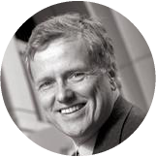
“It is impossible to find any domain in which humans clearly outperformed crude extrapolation algorithms, less still sophisticated statistical ones”
- Philip Tetlock
Author, Professor
Notes:
https://en.wikipedia.org/wiki/Philip_E._Tetlock

Slide 21



31
284
19 Years
82,361
Notes:
Professor Tetlock’s previous quote comes after extensive research.
He recorded the forecasts of 284 experts over 19 Years. They made over 82,000 forecasts and the tracked they track record.
He found that the people using formal models outperformed everyone else.

Slide 22


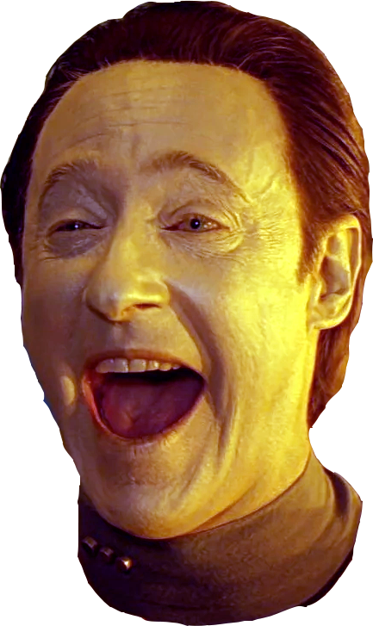
Value of Models
Consistent Analysis
Learning
Collaboration
Data can surprise you!
Notes:
Consistent Analysis
Formal models lead to a more consistent analysis.
They allow us to focus on parts of the problem without loosing sight of the bigger picture.
Learning
Have you ever done a risk analysis using Risk Matrices and you were surprised by the result? Like you would have bet the results will be “High” but turned out to be “Low” or vice versa?
It’s very unlikely, which should be telling us something, namely that an analysis using risk matrices merely documents decisions we have already made unconsciously rather than inform our decision making process.
In contrast if you using quantitative risk analysis methods we can get results that surprise us, we can gain new insights that challenge our intuition.
Collaboration:
Without models it is extremely difficult for a facilitator to maintain a rational discussion and controls the egos of the participants. The participants feel personally attacked when there is disagreement with their “opinion”.
In contrast in the quantitative approach using models the participants have already agreed to use the model and the efforts are focused on finding the best data to feed into the model. The discussions moves from judging opinions to a discussion on the relevance of data and it’s role in the model.

Slide 23
Ignoring Uncertainty

Slide 24
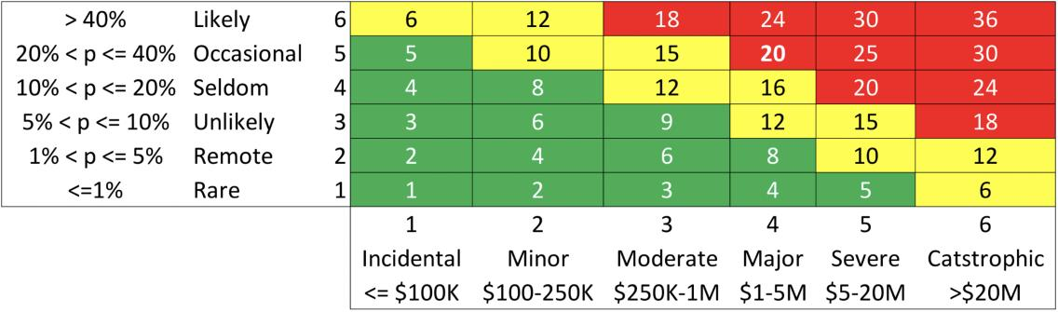
Ignoring Uncertainty
A typical risk matrix, all the analyst has to do is to pick a bin.

Slide 25
Ignoring Uncertainty
When we place a dot in one of the squares we express a single loss event.
Does that dot express the worst case, most likely or best case scenario.
Even if there is a understanding what the dot expresses, for example the most likely scenario, is it wise to simply ignore the rest of the possible scenarios?

Slide 26
Ignoring Uncertainty
When we choose a bin, how do we express how certain or confident we are in the allocation?
Even when you are unsure, you are forced to select a bin and no one asks you about how confident you are.
When you believe it could fall in one or the other bins, or somewhere in-between you are still forced to pick one bin and no one asks you about how confident you are in that selection.
When you make a selection everyone assumes that the analyst is pretty sure they selected the correct bin.
There is no inclusion of the risk analysts confidence level in the risk calculation, it’s simply ignored as if it doesn’t matter.

Slide 27
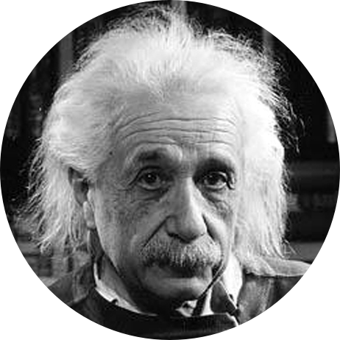
Ignoring Uncertainty
The reason is not that this approach makes sense or is somehow defensible but that a tool is proposed that supposedly is “simple” but in reality is “simplistic.”
The heat map just cannot deal with uncertainty or the reality that there is a range of probable future events.
Everything should be made as simple as possible, but not simpler.
- Bertrand Russell
English mathematician and philosopher
27

Slide 28
Expert Judgement

Slide 29
Expert Judgement
Qualitative as well as quantitative risk management depends heavily on input from subject matter experts.
Quantitative risk management acknowledges that experts are not perfect and introduces methods to make expert judgement more reliable.

Slide 30
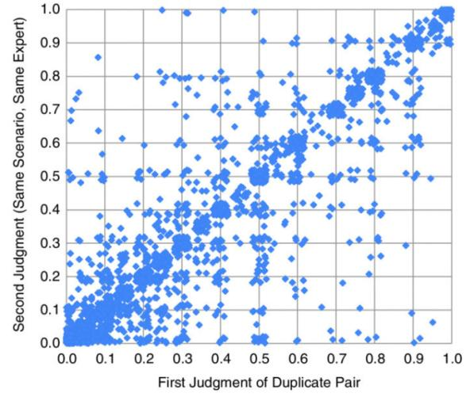
Expert Judgement
Not surprisingly to anyone, experts don’t always agree with each other. They have different opinions. Consensus among experts varies.
Research has shown that experts change their judgement. Basically they give different answers to the same question.
Source: Douglas W. Hubbard and Richard Seiersen: How to Measure Anything in Cybersecurity Risk
Notes:
Explain the chart:
Experts are given questions and requested to set probabilities. Some of the questions are repeated.
Ideally, if an experts answers the same questions twice we would expect the same answer which would result in a clean diagonal line.
However from the experiment we can see this is not the case.

Slide 31
Expert Judgement – Calibration Training
In quantitative risk management we try our best to use data whenever we can. However historic data is not necessarily a good indicator of future performance and thus we need expert judgement.
Calibration Training is one proven method to help experts make better judgements by embracing uncertainty and calibrating for over or under-confidence.
100%
Range of results for studies
of calibrated persons
90%
80%
Ideal Calibration
Overconfidence
Range of results from studies
of un-calibrated people
Actual Percent Correct
70%
60%
Average of Un-calibrated
50%
40%
50%
60%
70%
80%
90%
100%
Assessed Chance Of Being Correct
Source: Hubbard Decision Research
Notes:
Explain the chart:
The chart visualizes the results of experts answering trivia questions and expressing their confidence in their response.
The results are charted before (light blue curve) and after obtaining training (light green).
As we can see when someone says for example they are 70% confident they actually are closer to that estimate after training then before training. So basically they actually make 7 out of 10 correct answers more often after training then when they do before training.

Slide 32
Scale Response Psychology

Slide 33
Scale Response Psychology
The choices in scale design matter:
Direction matters (high to low, low to high, 1- 5, 5-1)
Number of buckets matters (1-5 vs. 1-10 etc.)
Centering Bias
Inconsistent interpretation of labels.
People mistake the labels as if they were values on a ratio scale.
Quantitative Risk management has no need for scales. Numbers are unambiguous.
Notes:
This is another example where extensive research has been made, but it is ignored in the “design” of risk matrices.
We should recall that Reference: Thomas, Philip & Bratvold, Reidar & Bickel, J. (2013). The Risk of Using Risk Matrices said
“These flaws cannot be corrected and are inherent to the design and use of RMs.”
Basically don’t waste your time trying to make this risk matrix better, some people for example believe making more bins will make it more precise. Or providing ”better” descriptions of the labels etc.
Direction: It matters if we use a 1 to 5 scale as opposed to a 5 to 1 scale. Responses vary.
Number of Buckets: Some believe by creating more bins like 5 x 10 matrix instead of 5 x 5 they create a higher level of precision. That’s not the case. Research has shown that bin 1 define exactly the same in a 1-5 matrix and 1-10 matrix is chosen more often in the 1-10 matrix.
Centering Bias: We have a centering bias, that’s one reason why we tend to have so many “medium” risks. Another reason is probably that it’s a safe bet, it isn’t an extreme that will attract scrutiny or will need major justification when it turns out to be wrong. It’s a tendency to playing it safe.
Interpretation of labels: Research shows that people tend to ignore the definitions of the labels and fall back on their own definitions.
Mistaken as ratio scale: People mistake the scale as a ratio scale i.e. likely hood of “4” is twice as likely as “2” etc.

Slide 34
Cognitive Biases

Slide 35
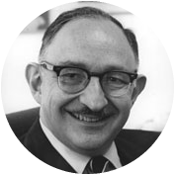
Cognitive Biases
We have a whole module on this subject following up.
In summary people make decisions that don’t conform to what we expect to be rational of logical. Qualitative RM ignores this insight and does not try to compensate for it, maybe it even amplifies it in some cases by holding up the illusion that risk matrices are some valid best practice based on validated research.
“Modern methods of dealing with the unknown start with measurement, with odds and probabilities. Without numbers, there are no odds and no probabilities; without odds and probabilities, the only way to deal with risk is to appeal to the gods and the fates. Without numbers, risk is wholly a matter of gut.”
- Peter Bernstein
American financial historian, economist and educator

Slide 36
Risk Aggregation

Slide 37
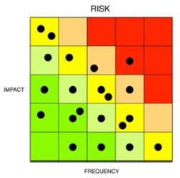
Risk Aggregation
While we can do risk management to address tactical or operational decision making eventually risks need to be reported up to management.
At some level what is more of interest is a picture of the whole risk landscape, an aggregated view of all risks that the organization faces.
For example business might want to know what risks it is facing:
This year
In a particular business unit
To a specific asset
To a specific objective
?

Slide 38


Risk Aggregation
These kind of aggregations by counting dots or colors are meaningless.
Impact
1
2
3
4
5
2018
2017
5
6
2
4
10
10
Likelihood
3
14
12
2
13
26
1
7
18
Total Risk Score: 452
452

Slide 39
Risk Aggregation
2018
$8M
$30M
$80M
$120M
$150M
min
25th
median
75th
max
2017
Productivity
(e.g. Business Interruption)
$1M
$40M
$90M
$100M
$120M
min
25th
median
75th
max
Replacement
(e.g. Capital Asset)
Response
(e.g. Incident Response)
Competitive Advantage
(e.g IP,…)
Reputation
(e.g Stakeholder Impact)
Fines & Judgements
(e.g Civil & Govmnt Fines)
$0
$20M
$40M
$60M
$80M
$100M
$120M
Notes:
Since we are dealing with actual numbers there are better methods to model aggregation and visualize it.

Slide 40
Risk Communication

Slide 41
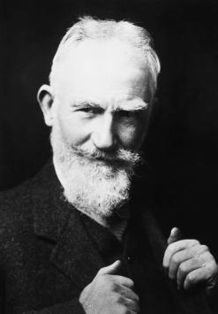
Risk Communication
“The single biggest problem in communication is the illusion that it has taken place.”
- Bernard Shaw
Irish playwright, critic, political activist, Nobel Prize in Literature.

Slide 42

Risk Communication
“The Risk Matrix is at best cosmetics or theatre and creates a delusion and confidence that risks are understood and being managed. This overconfidence which is particularly psychologically induced by the change of colours is in fact the real risk associated with the Risk Matrix. The risk industry would be much better served if this delusional device was eradicated.”
- Dr. Robert Long
Fallibility and Risk – Living With Uncertainty
Notes:
https://safetyrisk.net/fallibility-and-risk-free-download-of-dr-longs-latest-book/

Slide 43
Risk Communication
Is the “dot” representing best-case, worst-case or something in between?
A single dot does not represent the range of probable outcomes.
People interpret heat maps as ratios:
“Risk 10” is twice as bad as “Risk 5”
Likelihood “2” is twice as likely as “1”, Impact “10” is twice the impact “5”
All Impacts, probability have the same “range”
Research shows a “Lie Factor” of Heat maps in the range of 100’s (Edward Tufte called “14” a “Whopping lie”)*
Probability distributions convey more information more accurately; that can be rationally defended and used directly for decision making or fed into other models.
* : Thomas, Philip & Bratvold, Reidar & Bickel, J. (2013). The Risk of Using Risk Matrices.
Notes:
https://www.edwardtufte.com/tufte/

Slide 44
Risk Treatment

Slide 45
Risk Treatment
The objective of a risk analysis is to eventually enable making a decision.
Decision require the evaluation of multiple options.
There is no defensible way to make such decision using qualitative methods.
How do we decide defensibly that investment into option A is more justifiable than investment into option B?
Impact
1
2
3
4
5
5
4
A
Likelihood
3
B
2
1

Slide 46
Sensitivity Analysis

Slide 47
Sensitivity Analysis
Sensitivity analysis is a more advanced version of “What if” scenarios.
Is it more worthwhile (cost benefit analysis) to focus on reducing the probability of a loss event occurring or the loss impact?
Which controls matter the most?
With FAIR we have a model that defines more granular variables. For example Vulnerability, Probability of Action, Secondary Loss Magnitude etc.
Since we have a model, we work with numbers we can play out the impact of changing a variable on the risk. This in turn helps us identify where it makes more sense to focus our efforts on.

Slide 48
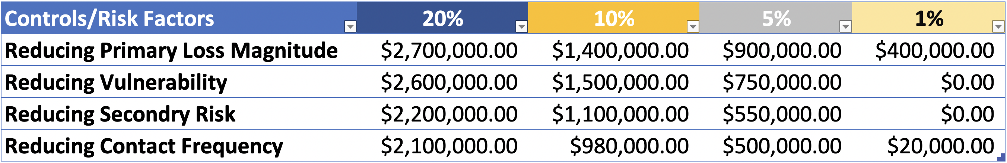
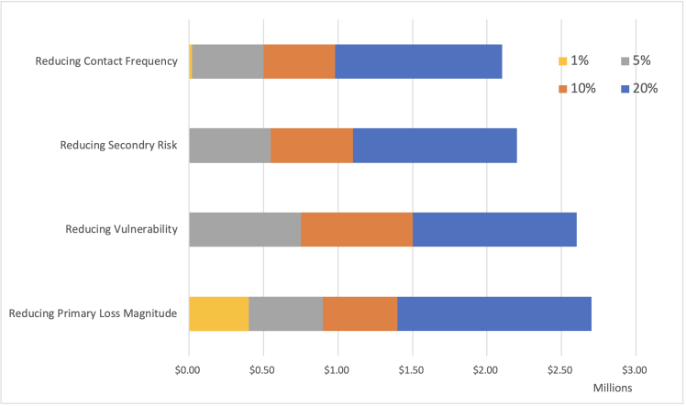
Sensitivity Analysis
Notes:
Illustrative Example
What happens if we can implement controls that change particular risk factor by improving them by 1%, 5%,10% or 20%?
That is known as a positive test.
A negative test would check the impact of risk factors becoming worse due to deteriorating controls etc.
In the above example we see that changes in factors effecting Primary Loss Magnitude have the largest impact in terms of reduction for example at 20% increase we can reduce the risk by $2.7m
The reduction can be measured against a chosen reference point for example average annualized risk exposure, risk exposure at the 90% percentile etc.

Slide 49
Sensitivity Analysis
Tornado Chart – showing impact of +/- 10% change in a risk factor
Productivity Loss
200K
1.5M
Threat Event Frequency
1
12
Replacement Loss
100K
600K
Vulnerability
40%
90%
$500K
$1M
$1.5M
$2M
$2.5M
$3M
$3.5M
Average Loss Exposure
Notes:
Illustrative Example

Slide 50
Skillset

Slide 51
Skillset
Qualitative Risk Management attitude: “Heat maps are so simple anyone can do it”.
Risk Analysis requires a particular skill set:
Critical Thinking
Basic Probability principles
Calibrated Estimation training
Familiarity with Monte Carlo Simulation
Psychology of Risk / Behavioral Economics
Data Quality

Slide 52
End of Module

